Slide 1

HTML Basics
Hypertext Markup Language
SoftUni Team
Technical Trainers
Software University
http://softuni.bg

Slide 2
Table of Contents
What is HTML?
Element Anatomy
Document Anatomy
Formatting Text
Attributes
Images, Links and Forms
Nested Elements

Slide 3
Questions?
sli.do
#tech-common

Slide 4

HTML
Standard for Markup Language

Slide 5
What is HTML?
Standard markup language for creating and displaying web content
It represents a series of elements that you use to wrap different portions of content to make them look and act in a certain way
HTML is not a programming language - it is a markup language that is used to tell your browser how to display the pages you are visiting
It’s just a text file with .html extension
Notes:
HTML (Hypertext Markup Language) is the code used to build and display a web page and its content
Standard markup language for creating web content
It represents a series of elements that you use to surround (or wrap) different portions of content to make them look and act in a certain way
HTML is not a programming language - it is a markup language that is used to tell your browser how to display the pages you are visiting.
It’s just a text file with .html extension.

Slide 6

Anatomy of an Element

Slide 7
Element Аnatomy
The main parts of an element are: Opening, Content and Closing tag
Opening tag - It consists of the name of the element surrounded by opening and closing angles. This indicates where the element starts.
Character (Tag name)
Left angle bracket (Less than sign)
Right angle bracket (Greater-than sign)
<html>

Slide 8
Element Аnatomy
Closing tag - Same as the opening tag, but with an additional slash before the item's name. This shows where the element ends
Character (Tag name)
Left angle bracket (Less than sign)
Right angle bracket (Greater-than sign)
</html>
Forward slash (end tag indicator)

Slide 9
Element Anatomy
Everything between the opening and closing tags is defined as the content of this element
The element is the set of the opening tag, closing tag and content
<html> <!-- HTML ELEMENT CONTENT--> </html>
<p> Hello, HTML! </p>

Slide 10
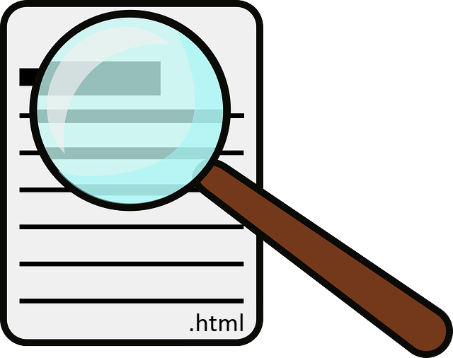
Document Anatomy

Slide 11
Document Anatomy
The basic requirement for content that a html file should have
<!DOCTYPE html> <html lang="en"> <head> <meta charset="UTF-8"> <title>HTML</title> </head> <body>
. . .
</body> </html>

Slide 12

<!DOCTYPE html>
Describes the HTML
It is an instruction for the web browser about what version of HTML the page is written in
The DOCTYPE is supported by all modern web browsers like: Chrome, Firefox, IE, Safari and Opera
<!DOCTYPE html>
. . .

Slide 13

The <html> tag
This element surrounds the entire content of the page
The html element must contain a head element followed by a body element
<!DOCTYPE html> <html> <head> . . . </head> <body> . . . </body> </html>

Slide 14

The <head> tag
Container for metadata
HTML metadata is data about the HTML document but is NOT displayed
Metadata typically define the document title, styles, links, scripts, and other meta information
<!DOCTYPE html> <html> <head> <!-- HEAD ELEMENT CONTENT--> </head> <body> . . .
</body> </html>
<head>

Slide 15
The <meta> tag
The information inside the <meta> tag is not displayed on the page but is relied on by the machine
Meta elements are usually used to add a description to the page, keywords or character sets.
Meta tags are always in the <head> element
Notes:
The metadata is used by the browser to know how to load the page or reload it, from the search engines (keywords) or other web services.
<meta> tags are always in the <head> element.
Meta elements are usually used to add a description to the page, keywords or character sets.

Slide 16
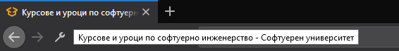
The <title> tag
Defines the title of the document
Defines the title in the browser's toolbar
Gives a page title when added to favorites
Shows the title of the page in the search engines
Title

Slide 17
The <body> tag
Defines the main content of the HTML document or the section of the HTML document that will be directly visible on your web page
<!DOCTYPE html> <html> <head> … </head> <body> <!-- BODY ELEMENT CONTENT--> </body> </html>
Notes:
Head is required and it should be used just once. It should start immediately after the opening html tag and end before the opening body tag.
<body> tag defines the main content of the HTML document or the section of the HTML document that will be directly visible on your web page.

Slide 18

Formatting Тext

Slide 19
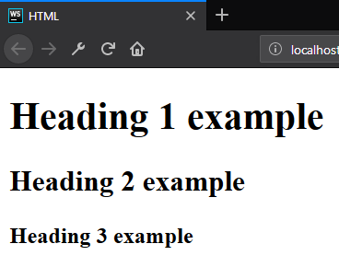
Formatting Text - Heading
Allow you to specify that certain portions of the content are titles or subheadings
<body> <h1>Heading 1 example</h1> <h2>Heading 2 example</h2> <h3>Heading 3 example</h3> </body>

Slide 20
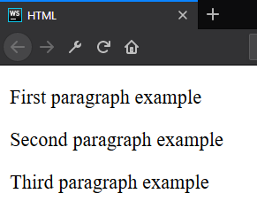
Formatting Text - Paragraph
Are meant to contain the individual paragraphs in the text
<body> <p>First paragraph example</p> <p>Second paragraph example</p> <p>Third paragraph example</p> </body>

Slide 21
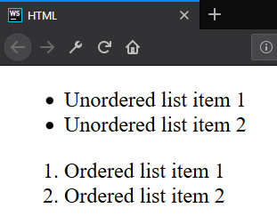
Formatting Text - List
The lists contain at least two elements.
The most common types are ordered and unordered lists
<ul> <li>Unordered list item 1</li> <li>Unordered list item 2</li> </ul> <ol> <li>Ordered list item 1</li> <li>Ordered list item 2</li> </ol>

Slide 22
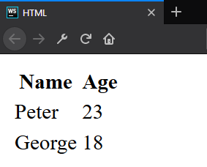
Formatting Text - Table
Table - Is a structured set of data made up of rows and columns
<table> <thead> <tr><th>Name</th><th>Age</th></tr> </thead> <tbody> <tr><td>Peter</td><td>23</td></tr> <tr><td>George</td><td>18</td></tr> </tbody> </table>

Slide 23
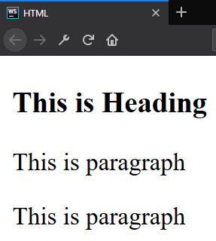
Formatting Text – Division Element
Division element (div) is the generic container for flow content. It has no effect on the content or layout
As a "pure" container, the <div> element does not inherently represent anything
<div> <h3>This is Heading</h3> <p>This is paragraph</p> <p>This is paragraph</p> </div>

Slide 24
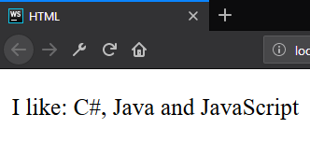
Formatting Text - Span
Span element is a generic inline container for phrasing content, which does not inherently represent anything. It can be used to group elements for styling purposes
<p> I like: <span>C#, Java and JavaScript</span> </p>

Slide 25
id?
class?
style?
name?
Attributes

Slide 26
Attributes
An attribute is a characteristic (special words) used inside the opening tag to control the tag's behavior.
In HTML, an attribute is a characteristic of a page element, such as font size or color.
Must have space
No space allowed
No space allowed
<p id="myId"></p>
Attribute
name
Attribute
value

Slide 27
Attributes
Attributes are used to amplify a tag. When a Web browser interprets an HTML tag, it will also look for its attributes so that it can display the Web page's elements properly.
Generally appear as name-value pairs, separated by '='.
<div class="divElement" id="mainContainer" In this case, the attributes will not affect the content of the div. </div>
Full list of all HTML attributes: Here

Slide 28



Images, Link and Forms

Slide 29

Images
The src (source-source) attribute indicates the path to the image file
The alt (alternate-substitute) attribute define descriptive text for users who can not see the image for some reason.

Slide 30

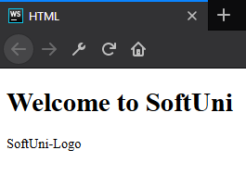
Images
<body> <h1>Welcome to SoftUni</h1> <img src="softuni-logo.png" alt="SoftUni-Logo"/> </body>
<body> <h1>Welcome to SoftUni</h1> <img src="softuniii-logo.png" alt="SoftUni-Logo"/> </body>

Slide 31
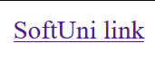
Links / References
They are the essence of the Web
To add a reference, we use this simple element <a>, as it comes from anchor
It needs an attribute to hold the reference we want to make. This attribute is called href from hypertext reference
<body> <a href="https://softuni.bg">SoftUni link</a> </body>

Slide 32
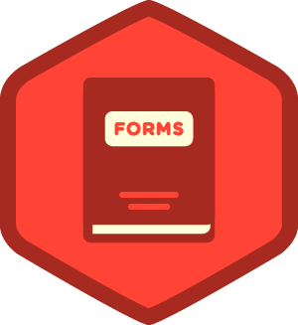
Forms
Forms are one of the main points of interaction between a user and a web site or application
An HTML Form is made of one or more widgets. Those widgets can be text fields (single line or multiline), select boxes, buttons, checkboxes, or radio buttons

Slide 33
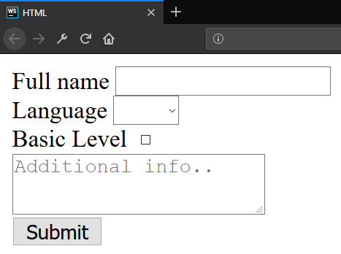
Forms
<form>
<label for="fullName">Full name</label>
<input id="fullName" type="text" name="fullName"/>
<label for="language">Language</label>
<select id="language">
// TODO: Add <option> tags
</select><br>
<label for="knowledge">Basic Level</label>
<input id="knowledge" type="checkbox" name="language" value="yes"><br>
<button type="submit">Submit</button></form>

Slide 34
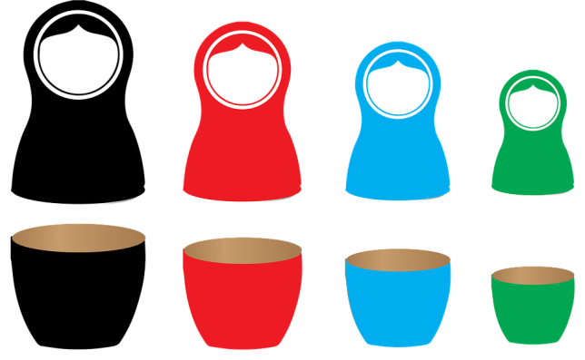
Nested Elements

Slide 35


Nested Elements
It is possible to put an element inside another element - this is called nesting
Elements need to be opened and closed properly to be truly inside or outside of each other
Some items have no content and are called empty elements

Slide 36
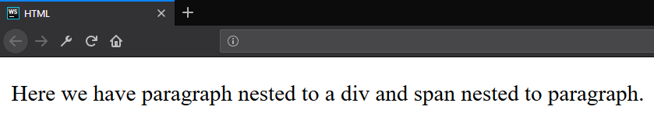
Nested Elements - Example
<div> <p>Here we have paragraph nested to a div and <span>span nested to paragraph</span>.</p> </div>

Slide 37

Summary
What is HTML?
Element anatomy
Document anatomy
Formatting text
Attributes
Images, Links and Forms
Nested Elements
…
…
…

Slide 38
https://softuni.bg/trainings/courses

Slide 39













SoftUni Diamond Partners

Slide 40




SoftUni Organizational Partners

Slide 41




Trainings @ Software University (SoftUni)
Software University – High-Quality Education and Employment Opportunities
softuni.bg
Software University Foundation
http://softuni.foundation/
Software University @ Facebook
facebook.com/SoftwareUniversity
Software University Forums
forum.softuni.bg

Slide 42

License
This course (slides, examples, demos, videos, homework, etc.) is licensed under the "Creative Commons Attribution-NonCommercial-ShareAlike 4.0 International" license

